Slide 1

MORE COMPLEX CONSTRAINTS

Slide 2
COURSE TIMELINE
Programming Projects with Lua
Roblox Studio Basics
Constraints Pt 1
Constraints Pt 2
Intro to Lua
Parameters
Loops & Conditionals
Functions
W1
W2
W3
W4
W5
W6
W7
W8

Slide 3

Edmodo
Resource Hub
Slides
Learning Material
Exercises/ Assignments / Quizzes
Tutorial Videos
WHEN TO CHECK
FRIDAY AFTERNOON EVERY WEEK
Communication
Directly message teachers
Post Questions
Post Screenshots of your work

Slide 4
Getting Started
Download
Worksheet Wk3
Lesson3.rblx
Lesson3_Extension.rblx

Slide 5
TODAY’S LESSON
1
REVIEW: CONSTRAINTS
2
CONSTRAINTS: MORE COMPLEX EXAMPLES
3
CLASS ACTIVITY
4
CLASS PROJECT: RACING GAME

Slide 6
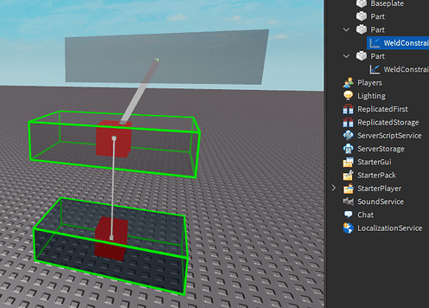
REVIEW: CONSTRAINTS
We use constraints to join two objects together.
TYPES OF CONSTRAINTS
BALL-IN SOCKET
HINGES
PRISMATIC
CYLINDRICAL
WELDS
Notes:
Go through real life examples (see worksheet Wk3)

Slide 7
REVIEW: OTHER CONSTRAINTS
ROPE CONSTRAINT
Constrain two attachments such that they are not separated from one another further than a specified distance.
ROD CONSTRAINT
SPRING CONSTRAINT
Constrain two attachments at a fixed distance, but they can both rotate freely.
When using a Spring Constraint, the points on each part will have an equal and opposite applied force.
String Constraints have a few special properties:
Damping
Stiffness
Limits
Notes:
Dampening (how long can it be a “spring”?) → How long the springs will be in motion, so if we streech it out really far its going to have a bigger damping effect.
Stiffness (can it be a spring at all?) →
Limits (how much can it “spring”?) → how much it can spring

Slide 8
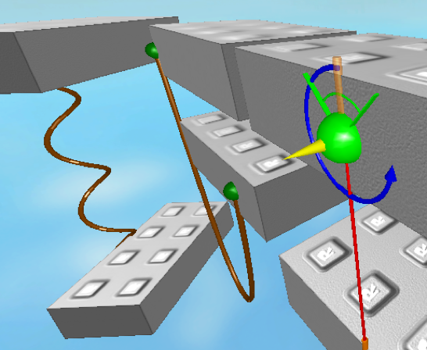
INSPIRATION FOR YOUR OBSTACLE COURSE GAME
Bricks joined together by rods that might fling around to attack your player and make them fall off the platform.
A block that rotates like a windmill, so your player has to time their jump in order to proceed.
Platform blocks tied to springs that suddenly drop if your player steps on it so they need to jump in order to survive.

Slide 9
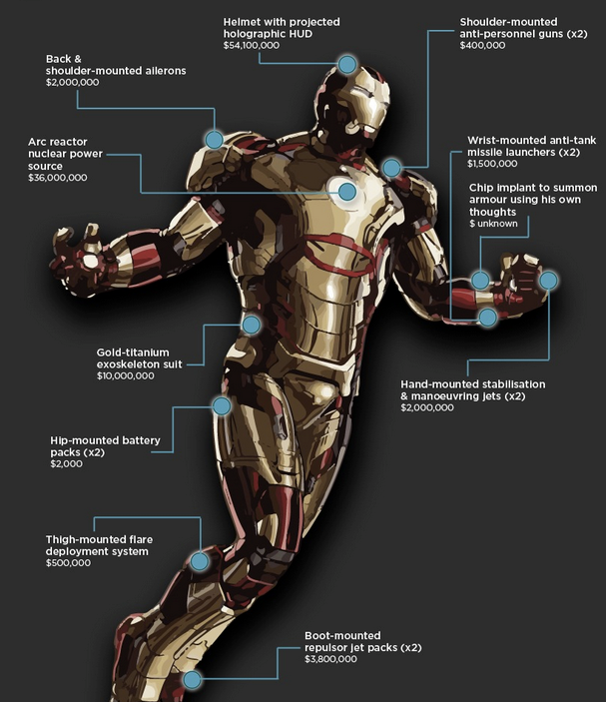
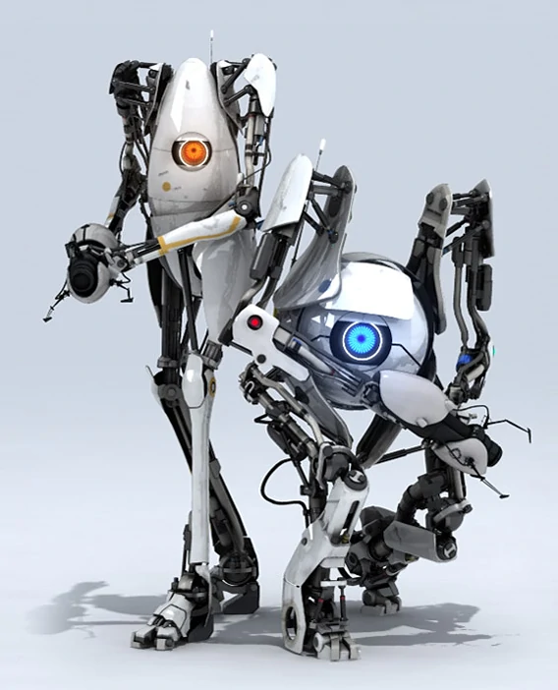
BUILDING THINGS WITH CONSTRAINTS
When we start looking at building more sophisticated games and machines, things can get complicated really fast.
In the real world, machines aren’t just made up of one constraint.
Often, we need to use multiple constraints (sometimes even hundreds) together to get machines to do stuff.

Slide 10
GAME DEVELOPMENT PROCESS
Here’s how game developers think. . .
IDEATE
DEVELOPMENT
LAUNCH
Figure out what you want to build and any cool features you might want to add.
Start building it using Roblox Studios. One step at a time.
Once your game is ready, publish and share it live onto Roblox!
DESIGN
TEST
Plan out what parts you need, the types of constraints and how it all works together. Then try breaking it down into steps for building
Continually test your machine! Test after you finish each component and anytime you add something new.

Slide 11
CLASS ACTIVITY

Slide 12
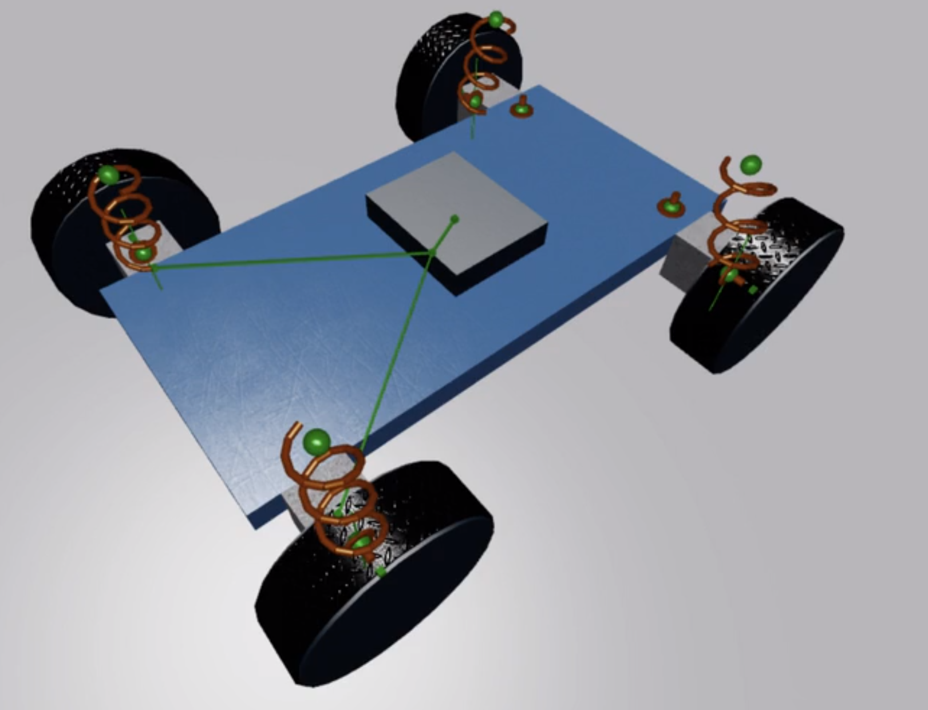
BUILDING A CAR
Game Development Process
IDEATE: We want to build a Racing Car in Roblox.
What should a car be able to do?
What are some cool features we could add?
DESIGN:
What parts can you see?
What constraints?
Where do we start?
TESTING:
When should we test?

Slide 13
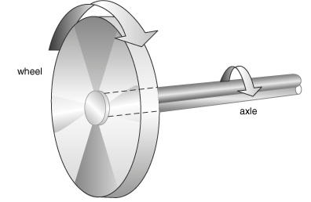
ANATOMY OF A CAR WHEEL
The edge of the wheel moves around more quickly, but with less force than the centre of the wheel.
An axle is a rod that passes through the centre of a wheel. In a road vehicle like a car the engine turns the axle to make the wheels go round.
The middle of the wheel moves around more slowly but with more turning force than the outside of the wheel.

Slide 14
CLASS PROJECT

